Slide 1

Advertising on the Web
Note to other teachers and users of these slides: We would be delighted if you found this our material useful in giving your own lectures. Feel free to use these slides verbatim, or to modify them to fit your own needs. If you make use of a significant portion of these slides in your own lecture, please include this message, or a link to our web site: http://www.mmds.org
Mining of Massive Datasets
Jure Leskovec, Anand Rajaraman, Jeff Ullman Stanford University
http://www.mmds.org

Slide 2
Online Algorithms
Classic model of algorithms
You get to see the entire input, then compute some function of it
In this context, “offline algorithm”
Online Algorithms
You get to see the input one piece at a time, and need to make irrevocable decisions along the way
Similar to the data stream model

Slide 3
Online Bipartite Matching

Slide 4
Example: Bipartite Matching
1
a
2
b
3
c
Boys
4
d
Girls
Nodes: Boys and Girls; Edges: Preferences
Goal: Match boys to girls so that maximum number of preferences is satisfied

Slide 5
Example: Bipartite Matching
1
a
2
b
3
c
Boys
4
d
Girls
M = {(1,a),(2,b),(3,d)} is a matching
Cardinality of matching = |M| = 3

Slide 6
Example: Bipartite Matching
Offline problem how?
1
a
Reduce it to max flow?
2
b
O(m*n) cost.
3
c
Boys
4
d
Girls
M = {(1,c),(2,b),(3,d),(4,a)} is a perfect matching
Perfect matching … all vertices of the graph are matched
Maximum matching … a matching that contains the largest possible number of matches

Slide 7
Matching Algorithm
Problem: Find a maximum matching for a given bipartite graph
A perfect one if it exists
There is a polynomial-time offline algorithm based on augmenting paths (Hopcroft & Karp 1973, see http://en.wikipedia.org/wiki/Hopcroft-Karp_algorithm)
But what if we do not know the entire graph upfront?

Slide 8
Online Graph Matching Problem
Initially, we are given the set boys
In each round, one girl’s choices are revealed
That is, girl’s edges are revealed
At that time, we have to decide to either:
Pair the girl with a boy
Do not pair the girl with any boy
Example of application: Assigning tasks to servers

Slide 9
Online Graph Matching: Example
1
a
(1,a)
2
b
(2,b)
(3,d)
3
c
4
d

Slide 10
Greedy Algorithm
Greedy algorithm for the online graph matching problem:
Pair the new girl with any eligible boy
If there is none, do not pair girl
How good is the algorithm?

Slide 11
Competitive Ratio
For input I, suppose greedy produces matching M_{greedy} while an optimal matching is M_{opt}
Competitive ratio =
min_{all possible inputs I} (|M_{greedy}|/|M_{opt}|)
(what is greedy’s worst performance over all possible inputs I)

Slide 12
Analyzing the Greedy Algorithm
Consider a case: M_{greedy}≠ M_{opt}
Consider the set G of girls matched in M_{opt} but not in M_{greedy}
Then every boy B adjacent to girls in G is already matched in M_{greedy}:
If there would exist such non-matched (by M_{greedy}) boy adjacent to a non-matched girl then greedy would have matched them
Since boys B are already matched in M_{greedy} then (1) |M_{greedy}|≥ |B|
M_{opt}
1
a
M_{greedy}
2
b
3
c
4
d
B={ }
G={ }

Slide 13
Analyzing the Greedy Algorithm
M_{opt}
Summary so far:
Girls G matched in M_{opt} but not in M_{greedy}
(1) |M_{greedy}|≥ |B|
There are at least |G| such boys (|G| ≤ |B|) otherwise the optimal algorithm couldn’t have matched all girls in G
So: |G| ≤ |B| ≤ |M_{greedy}|
By definition of G also: |M_{opt}| ≤ |M_{greedy}| + |G|
Worst case is when |G| = |B| = |M_{greedy}|
|M_{opt}| ≤ 2|M_{greedy}| then |M_{greedy}|/|M_{opt}| ≥ 1/2
1
a
M_{greedy}
2
b
3
c
4
d
B={ }
G={ }
Notes:
This is a general proof.
We make no assumptions about the structure of the bipartite graph.

Slide 14
Worst-case Scenario
1
a
(1,a)
2
b
(2,b)
3
c
4
d

Slide 15
Web Advertising

Slide 16

History of Web Advertising
Banner ads (1995-2001)
Initial form of web advertising
Popular websites charged X$ for every 1,000 “impressions” of the ad
Called “CPM” rate (Cost per thousand impressions)
Modeled similar to TV, magazine ads
From untargeted to demographically targeted
Low click-through rates
Low ROI for advertisers
CPM…cost per mille
Mille…thousand in Latin

Slide 17
Performance-based Advertising
Introduced by Overture around 2000
Advertisers bid on search keywords
When someone searches for that keyword, the highest bidder’s ad is shown
Advertiser is charged only if the ad is clicked on
Similar model adopted by Google with some changes around 2002
Called Adwords

Slide 18
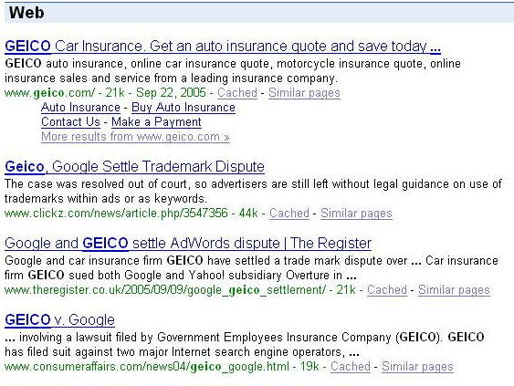
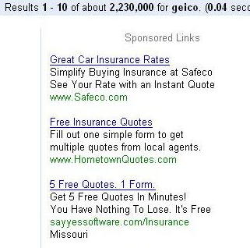
Ads vs. Search Results

Slide 19
Web 2.0
Performance-based advertising works!
Multi-billion-dollar industry
Interesting problem: What ads to show for a given query?
(Today’s lecture)
If I am an advertiser, which search terms should I bid on and how much should I bid?
(Not focus of today’s lecture)

Slide 20
Adwords Problem
Given:
1. A set of bids by advertisers for search queries
2. A click-through rate for each advertiser-query pair
3. A budget for each advertiser (say for 1 month)
4. A limit on the number of ads to be displayed with each search query
Respond to each search query with a set of advertisers such that:
1. The size of the set is no larger than the limit on the number of ads per query
2. Each advertiser has bid on the search query
3. Each advertiser has enough budget left to pay for the ad if it is clicked upon

Slide 21
Adwords Problem
A stream of queries arrives at the search engine: q₁, q₂, …
Several advertisers bid on each query
When query q_{i} arrives, search engine must pick a subset of advertisers whose ads are shown
Goal: Maximize search engine’s revenues
Simple solution: Instead of raw bids, use the “expected revenue per click” (i.e., Bid*CTR)
Clearly we need an online algorithm!

Slide 22
The Adwords Innovation
Advertiser
Bid
CTR
Bid * CTR
A
$1.00
1%
1 cent
B
$0.75
2%
1.5 cents
C
$0.50
2.5%
1.125 cents
Click through rate
Expected revenue

Slide 23
The Adwords Innovation
Advertiser
Bid
CTR
Bid * CTR
B
$0.75
2%
1.5 cents
C
$0.50
2.5%
1.125 cents
A
$1.00
1%
1 cent

Slide 24
Complications: Budget
Two complications:
Budget
CTR of an ad is unknown
Each advertiser has a limited budget
Search engine guarantees that the advertiser will not be charged more than their daily budget

Slide 25
Complications: CTR
CTR: Each ad has a different likelihood of being clicked
Advertiser 1 bids $2, click probability = 0.1
Advertiser 2 bids $1, click probability = 0.5
Clickthrough rate (CTR) is measured historically
Very hard problem: Exploration vs. exploitation Exploit: Should we keep showing an ad for which we have good estimates of click-through rate or Explore: Shall we show a brand new ad to get a better sense of its click-through rate

Slide 26
Greedy Algorithm
Our setting: Simplified environment
There is 1 ad shown for each query
All advertisers have the same budget B
All ads are equally likely to be clicked
Value of each ad is the same (=1)
Simplest algorithm is greedy:
For a query pick any advertiser who has bid 1 for that query
Competitive ratio of greedy is 1/2

Slide 27
Bad Scenario for Greedy
Two advertisers A and B
A bids on query x, B bids on x and y
Both have budgets of $4
Query stream: x x x x y y y y
Worst case greedy choice: B B B B _ _ _ _
Optimal: A A A A B B B B
Competitive ratio = ½
This is the worst case!
Note: Greedy algorithm is deterministic – it always resolves draws in the same way
Notes:
Is greedy deterministic or randomized (it is deterministic!!)

Slide 28
BALANCE Algorithm [MSVV]
BALANCE Algorithm by Mehta, Saberi, Vazirani, and Vazirani
For each query, pick the advertiser with the largest unspent budget
Break ties arbitrarily (but in a deterministic way)

Slide 29
Example: BALANCE
Two advertisers A and B
A bids on query x, B bids on x and y
Both have budgets of $4
Query stream: x x x x y y y y
BALANCE choice: A B A B B B _ _
Optimal: A A A A B B B B
In general: For BALANCE on 2 advertisers Competitive ratio = ¾

Slide 30
Analyzing BALANCE
Consider simple case (w.l.o.g.):
2 advertisers, A₁ and A₂, each with budget B (≥1)
Optimal solution exhausts both advertisers’ budgets
BALANCE must exhaust at least one advertiser’s budget:
If not, we can allocate more queries
Whenever BALANCE makes a mistake (both advertisers bid on the query), advertiser’s unspent budget only decreases
Since optimal exhausts both budgets, one will for sure get exhausted
Assume BALANCE exhausts A₂’s budget, but allocates x queries fewer than the optimal
Revenue: BAL = 2B - x
Notes:
Why exhausts budget:
-- remember, optimal exhausts both budgets
GENERAL PROOF

Slide 31
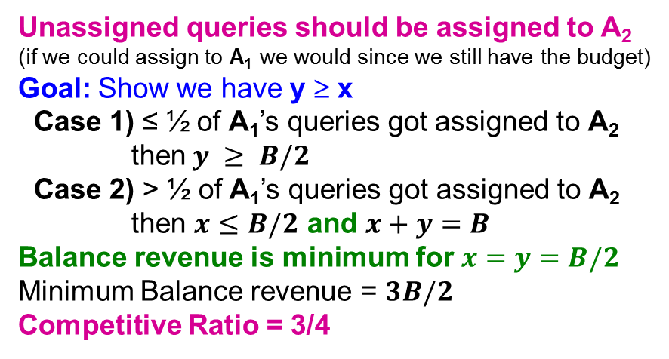
Analyzing Balance
Queries allocated to A₁ in the optimal solution
B
Queries allocated to A₂ in the optimal solution
A₁
A₂
Optimal revenue = 2B
Assume Balance gives revenue = 2B-x = B+y
x
B
Unassigned queries should be assigned to A₂
(if we could assign to A₁ we would since we still have the budget)
Goal: Show we have y ≥ x
Case 1) ≤ ½ of A₁’s queries got assigned to A₂ then $y ≥ B/2$
Case 2) > ½ of A₁’s queries got assigned to A₂ then $x≤B/2$ and $x+y=B$
Balance revenue is minimum for $x=y=B/2$
Minimum Balance revenue = $3B/2$
Competitive Ratio = 3/4
y
x
A₁
A₂
Not used
x
B
y
x
Consider last of A1s queries assigned to A2. At that time B2 > B1. So B1 < ½.
A₁
A₂
Not used
BALANCE exhausts A₂’s budget
Notes:
Whatever is not used should be assigned to A2 (since if we could assign to A1 we would since we still have the budget)
CASE 1) Less than half of A1’s queries got assigned to A2. So y>B/2
CASE 2) If more than half of A1’s queries got assigned to A2.
Consider last of A1s queries assigned to A2. At that time B2 > B1.
At that time B2 < ½. Since more than half of A1’s queries got assigned to A2 (this means the remaining budget had to be <1/2).
So B1<1/2.

Slide 32
BALANCE: General Result
In the general case, worst competitive ratio of BALANCE is 1–1/e = approx. 0.63
Interestingly, no online algorithm has a better competitive ratio!
Let’s see the worst case example that gives this ratio

Slide 33
Worst case for BALANCE
N advertisers: A₁, A₂, … A_{N}
Each with budget B > N
Queries:
N∙B queries appear in N rounds of B queries each
Bidding:
Round 1 queries: bidders A₁, A₂, …, A_{N}
Round 2 queries: bidders A₂, A₃, …, A_{N}
Round i queries: bidders A_{i}, …, A_{N}
Optimum allocation: Allocate round i queries to A_{i}
Optimum revenue N∙B

Slide 34
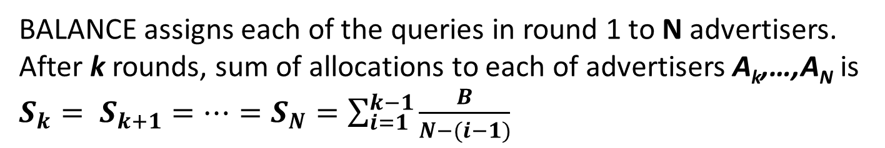
BALANCE Allocation
…
B/(N-2)
B/(N-1)
B/N
A₁
A₂
A₃
A_{N-1}
A_{N}
BALANCE assigns each of the queries in round 1 to N advertisers. After k rounds, sum of allocations to each of advertisers A_{k},…,A_{N} is $S_{k}= S_{k+1}=…=S_{N}=\sum_{i=1}^{k−1}{\frac{B}{N−(i−1)}}$
If we find the smallest k such that S_{k} ≥ B, then after k rounds
we cannot allocate any queries to any advertiser

Slide 35
BALANCE: Analysis
B/1 B/2 B/3 … B/(N-(k-1)) … B/(N-1) B/N
S₁
S₂
S_{k} = B
1/1 1/2 1/3 … 1/(N-(k-1)) … 1/(N-1) 1/N
S₁
S₂
S_{k} = 1

Slide 36
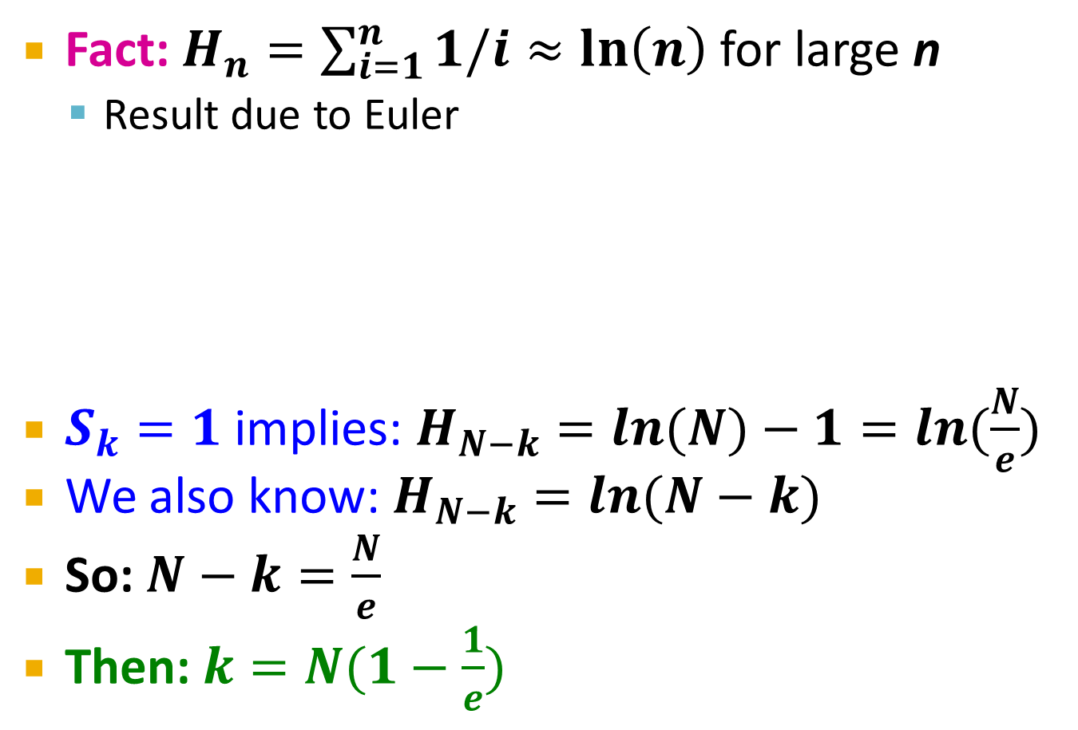
BALANCE: Analysis
Fact: $H_{n}=\sum_{i=1}^{n}{1/i}≈\ln\left(n\right)$ for large n
Result due to Euler
$S_{k}=1$ implies: $H_{N−k}=ln⁡(N)−1=ln⁡(\frac{N}{e})$
We also know: $H_{N−k}=ln⁡(N−k)$
So: $N−k=\frac{N}{e}$
Then: $k=N(1−\frac{1}{e})$
1/1 1/2 1/3 … 1/(N-(k-1)) … 1/(N-1) 1/N
ln(N)
ln(N)-1
S_{k} = 1
N terms sum to ln(N).
Last k terms sum to 1.
First N-k terms sum to ln(N-k) but also to ln(N)-1

Slide 37
BALANCE: Analysis
So after the first k=N(1-1/e) rounds, we cannot allocate a query to any advertiser
Revenue = B∙N (1-1/e)
Competitive ratio = 1-1/e

Slide 38
General Version of the Problem
Arbitrary bids and arbitrary budgets!
Consider we have 1 query q, advertiser i
Bid = x_{i}
Budget = b_{i}
In a general setting BALANCE can be terrible
Consider two advertisers A₁ and A₂
A₁: x₁ = 1, b₁ = 110
A₂: x₂ = 10, b₂ = 100
Consider we see 10 instances of q
BALANCE always selects A₁ and earns 10
Optimal earns 100

Slide 39
Generalized BALANCE
Arbitrary bids: consider query q, bidder i
Bid = x_{i}
Budget = b_{i}
Amount spent so far = m_{i}
Fraction of budget left over f_{i} = 1-m_{i}/b_{i}
Define ψ_{i}(q) = x_{i}(1-e^{-fi})
Allocate query q to bidder i with largest value of ψ_{i}(q)
Same competitive ratio (1-1/e)

